Slide 1

Searching And Sorting

Slide 2


Slide 3
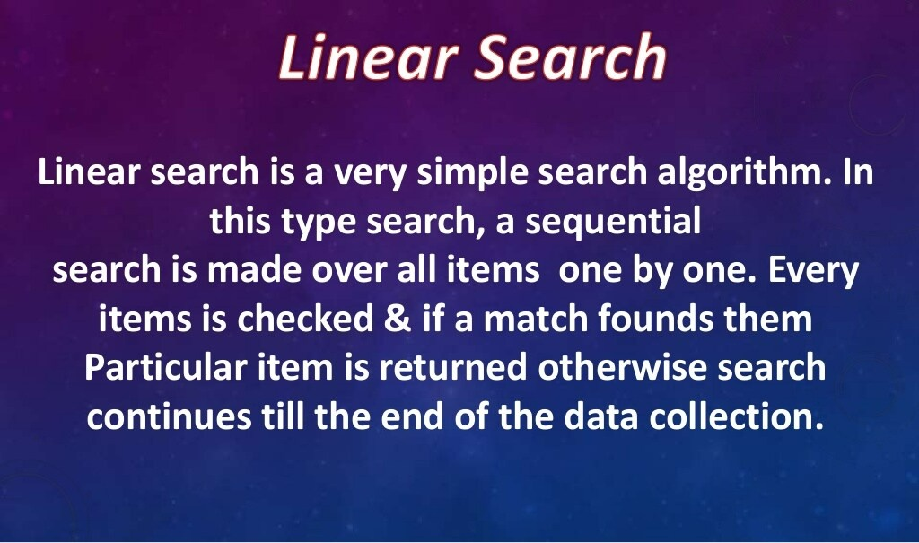

Slide 4
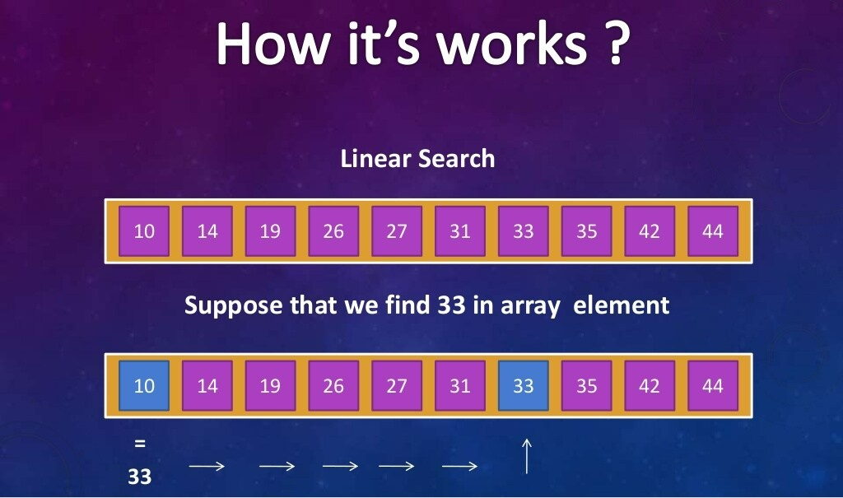

Slide 5
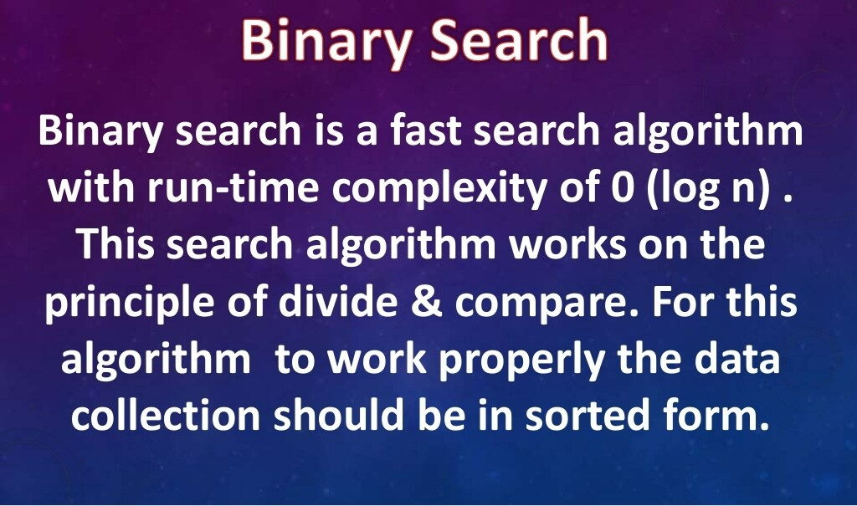

Slide 6
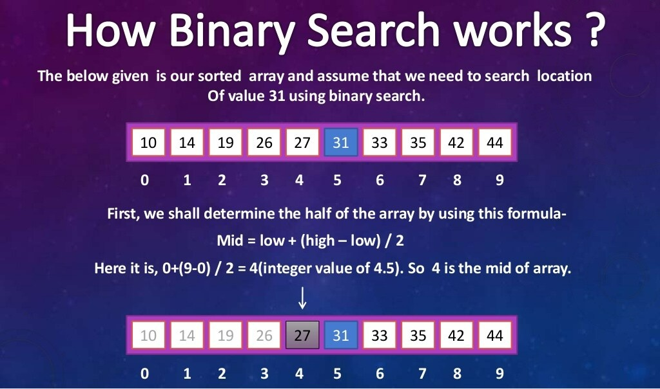

Slide 7
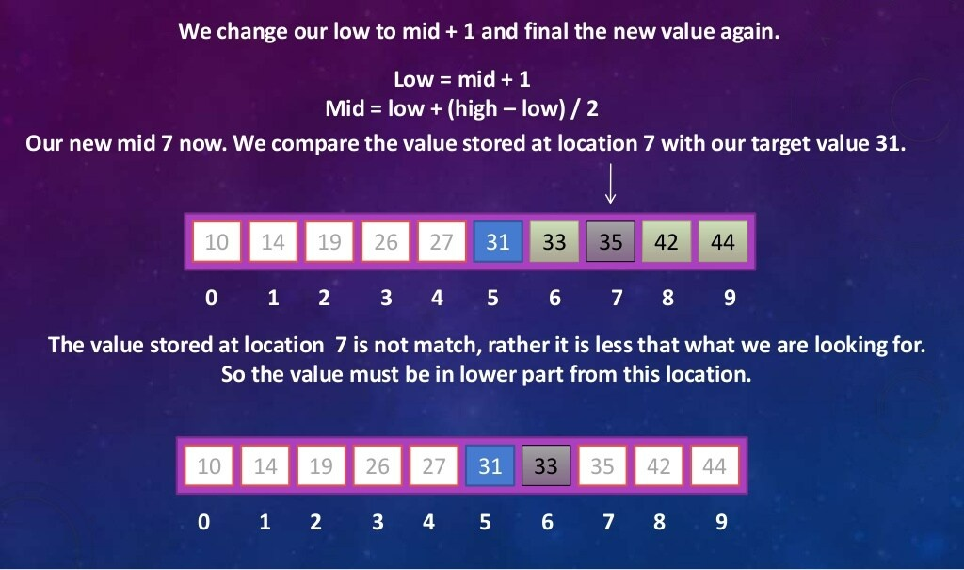

Slide 8
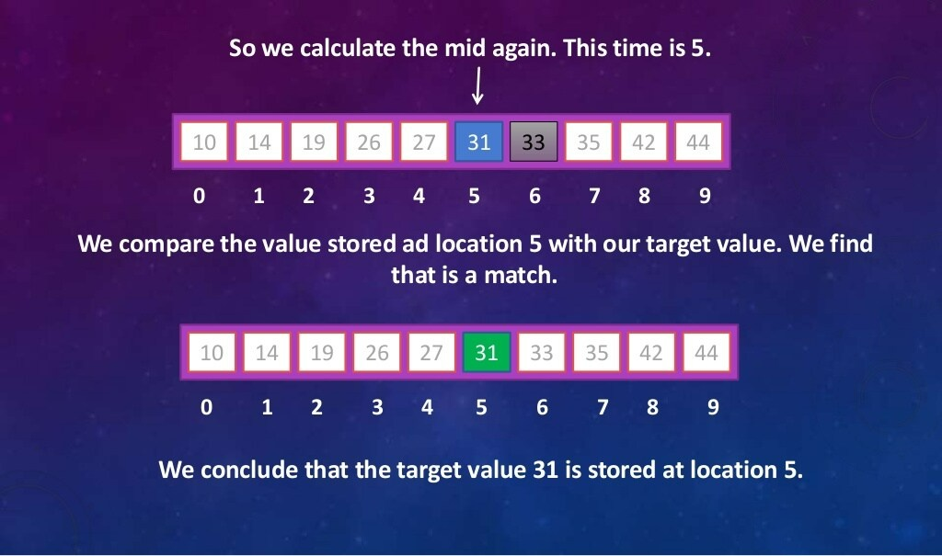

Slide 9
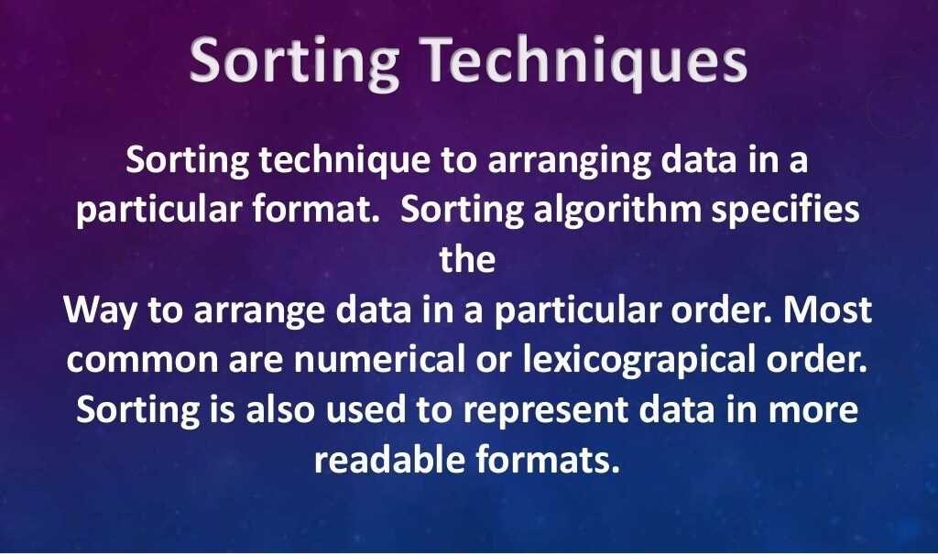

Slide 10
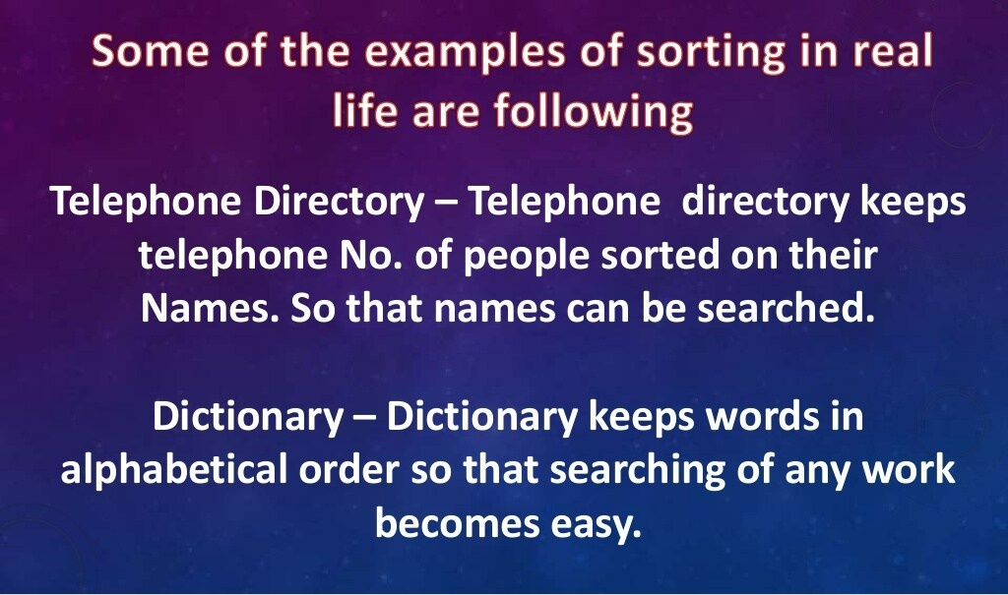

Slide 11
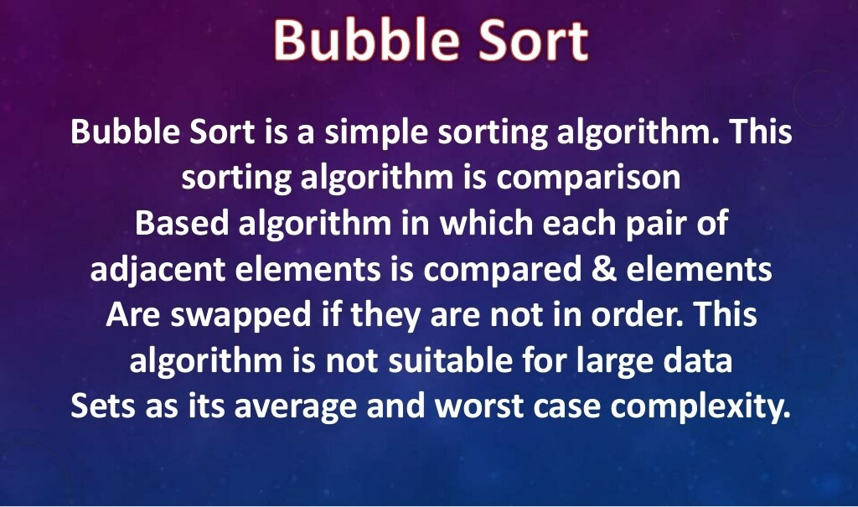

Slide 12
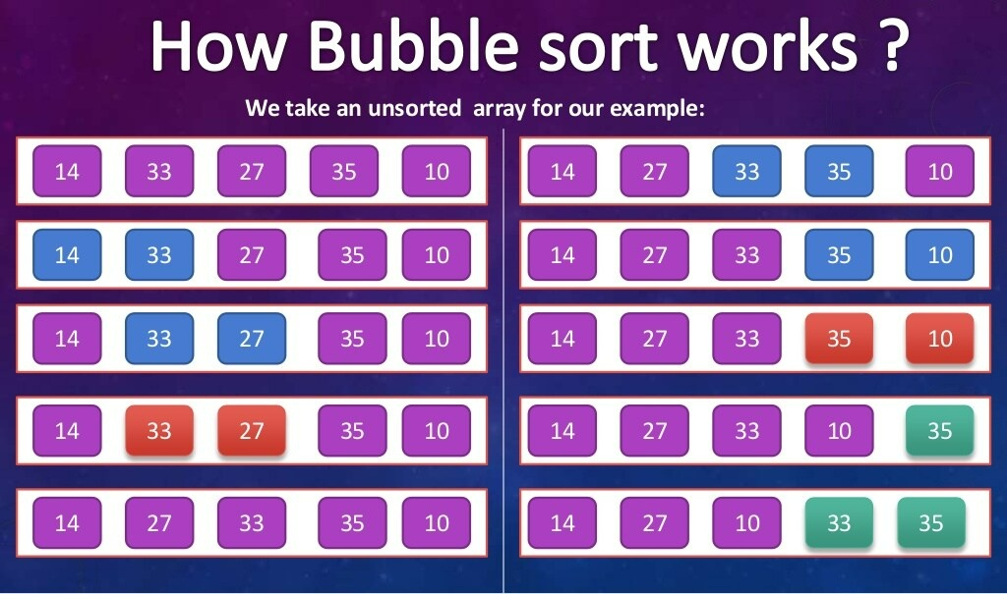

Slide 13
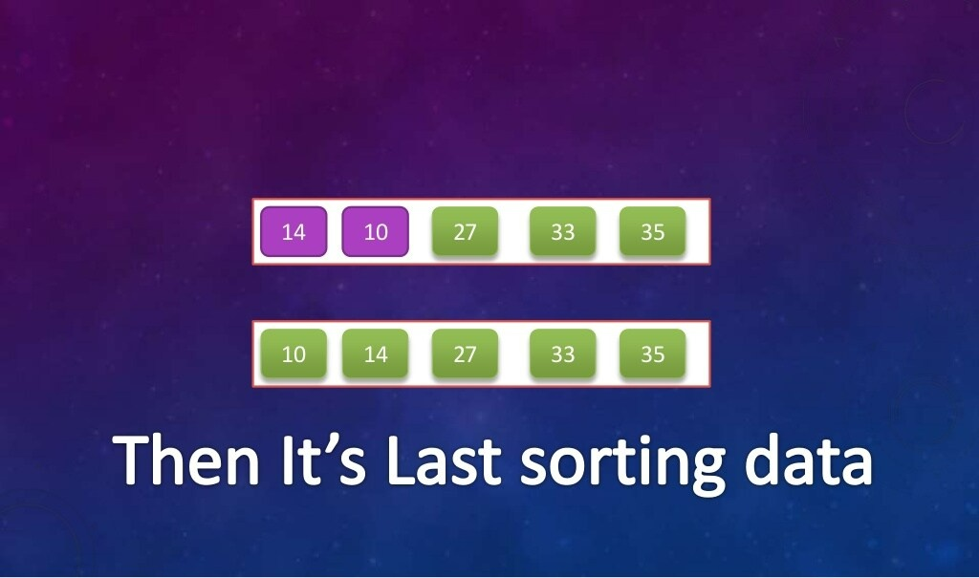

Slide 14
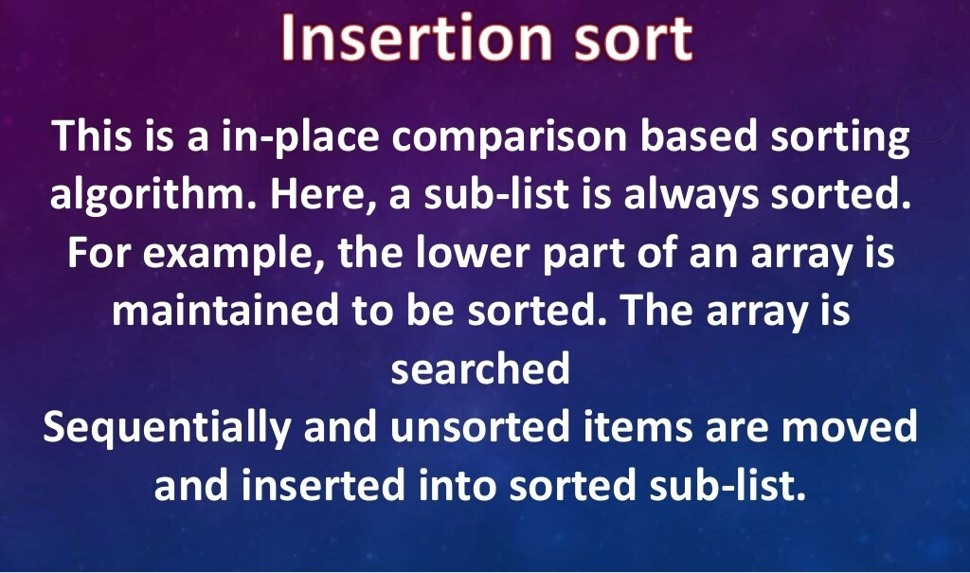

Slide 15
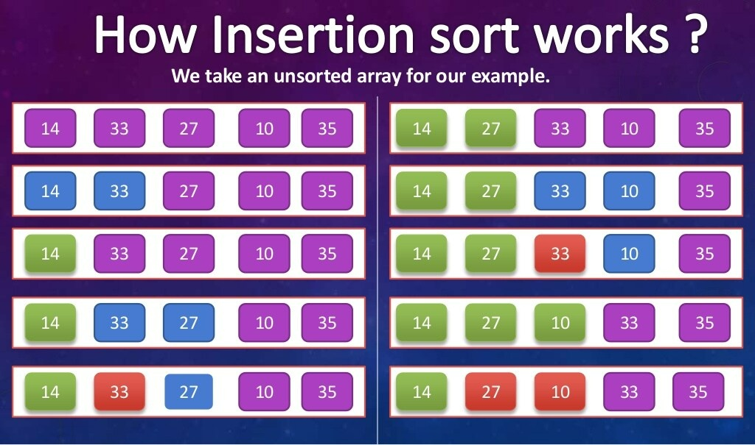

Slide 16
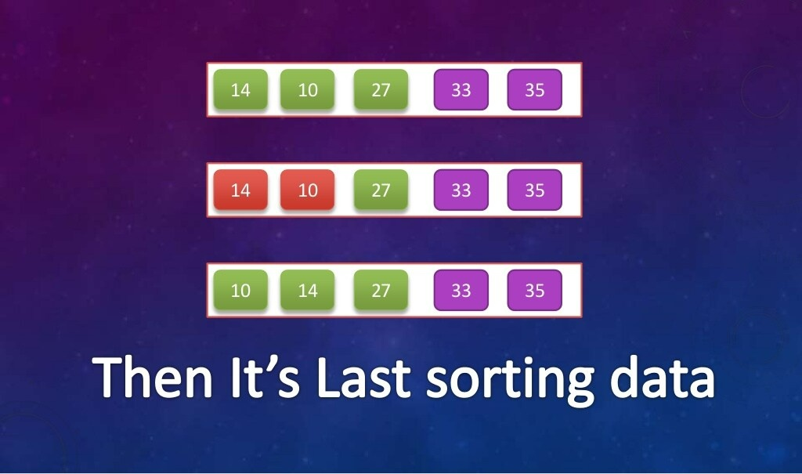

Slide 17
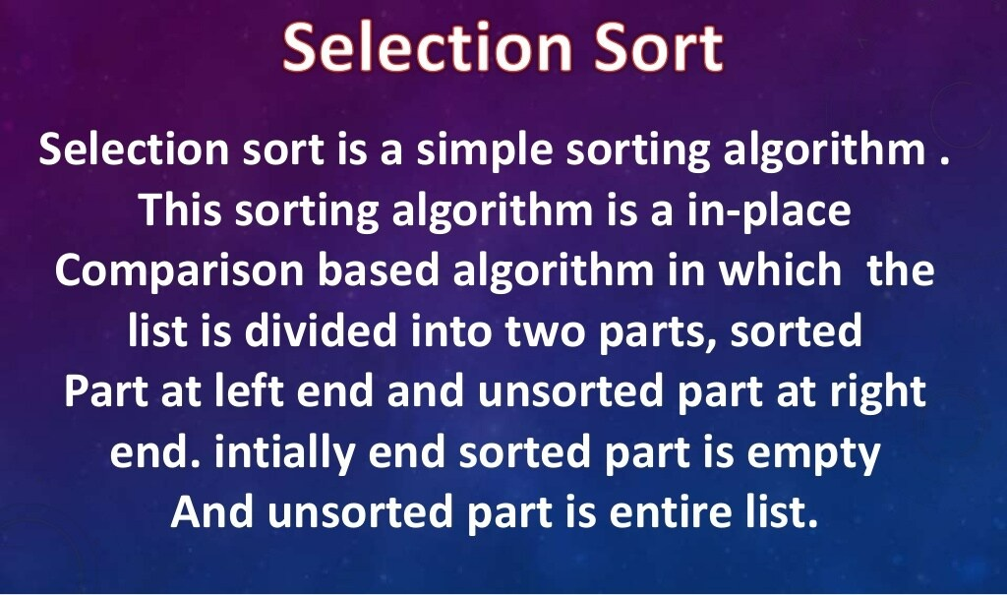

Slide 18
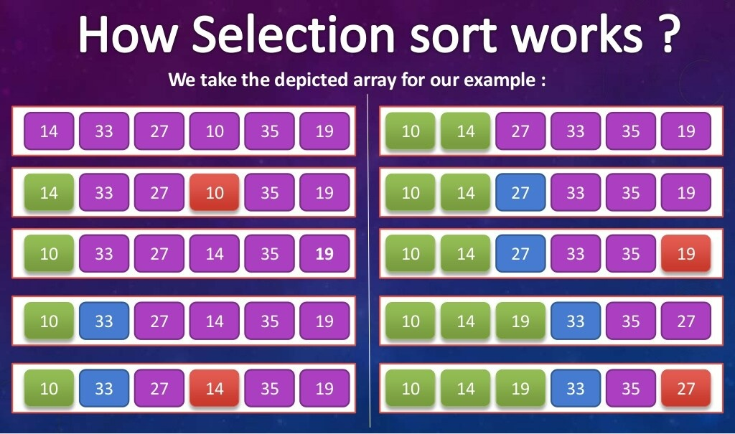

Slide 19
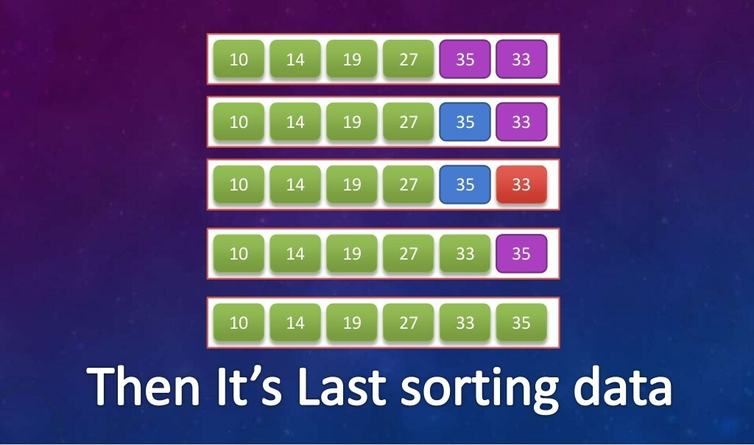

Slide 20
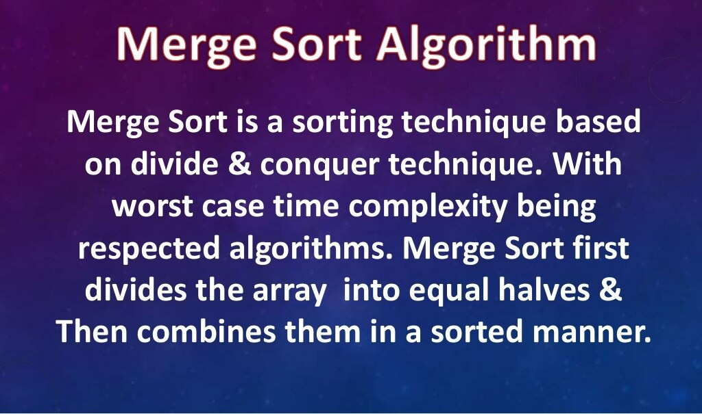

Slide 21
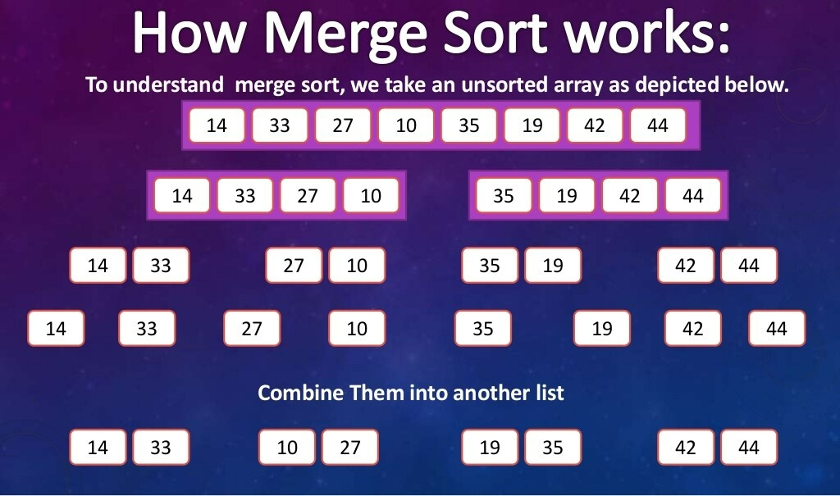

Slide 22
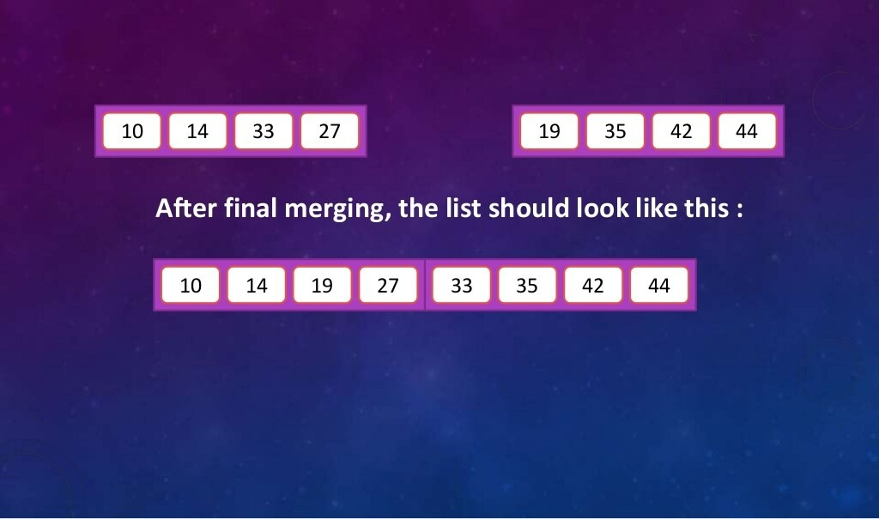

Slide 23
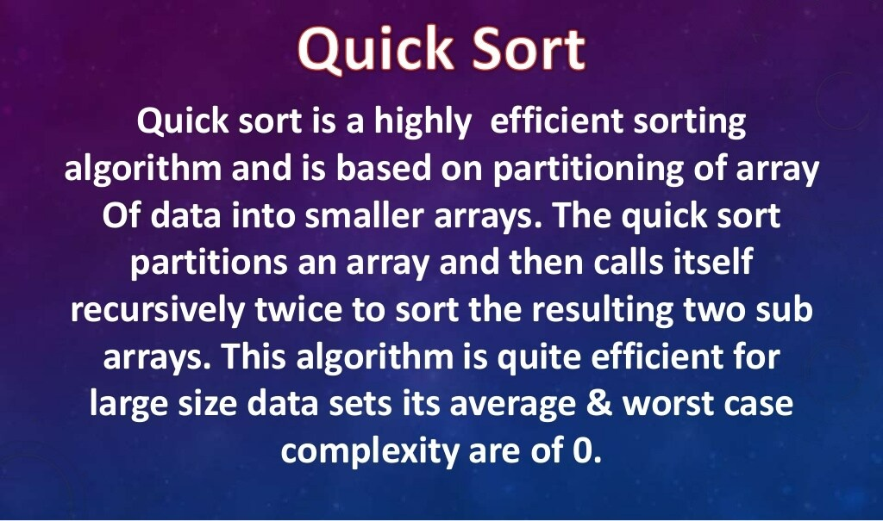

Slide 24
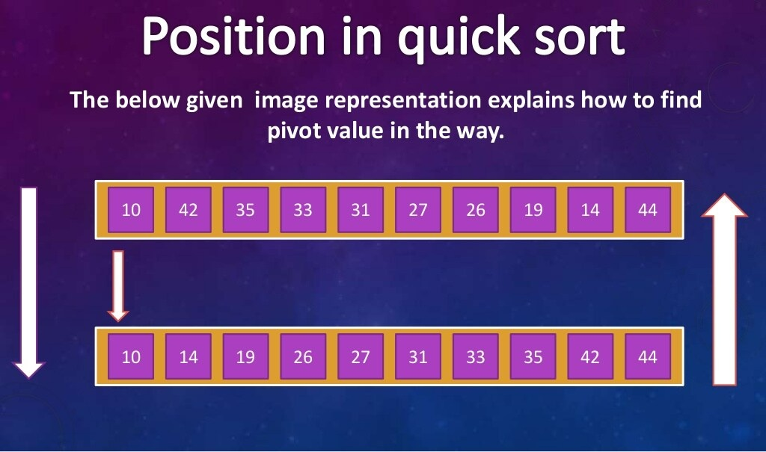

Slide 25
Searching & Sorting algorithms are one of the basic topics taught at first in the data structures and algorithms course at university. To test a persons proficiency in Searching and Sorting :
He should take right decision by choosing right algorithm in right situation . Consider that we are making an online shopping application. We want to let the users view items in the increasing order of price. For this, he have to sort the items by the price.
He should be proficient enough in time and space complexity concepts which play a major role in these algorithms.
He should get his hands dirty with code then only he can implement the logic required for these algorithms.
I would test a person in this manner to verify whether he is proficient in this concept or not.

Slide 26

A presentation by M.Saketh

